Slide 1
Reverse-Engineering Flash Files with SWFRETools
Sebastian Porst (sp@porst.tv) – SOURCE Boston 2011
Notes:
http://www.flickr.com/photos/markchadwick/4592186576/

Slide 2





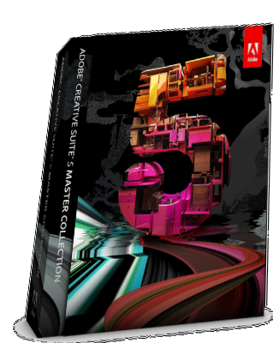
About Me
Notes:
http://www.flickr.com/photos/markchadwick/4592186576/

Slide 3
Current Work
Look at crash
Root cause analysis
Minimal repro file
Detection logic

Slide 4



What this talk is about
Ship it!

Slide 5
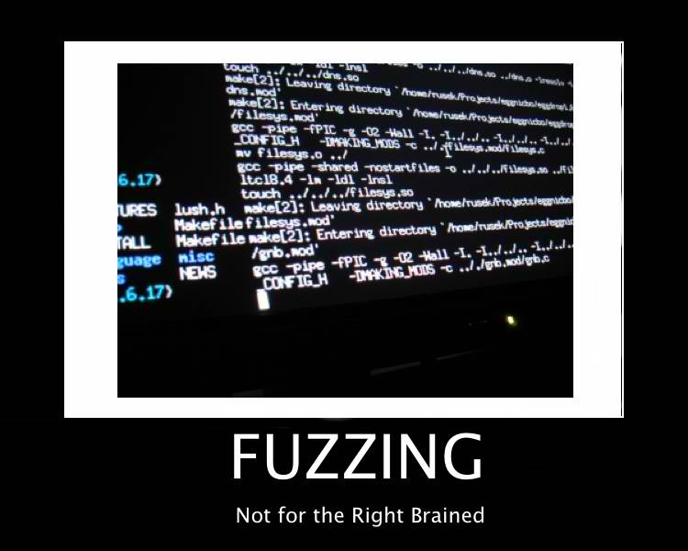
What this talk is not about

Slide 6
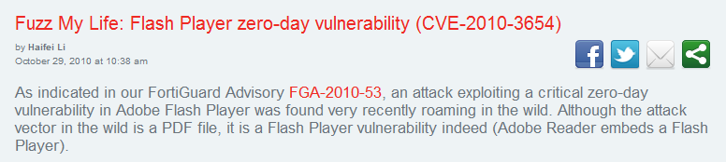
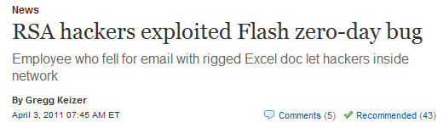
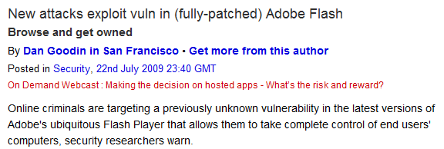
Why is this relevant?

Slide 7
SWF Files: An Overview
Header
Tag 1
Tag 2
Tag 3
Tag 4
…
Tag n

Slide 8
SWF Files: Interesting Aspects
SWF Parser
ActionScript 2
ActionScript 3
Embedded Media (Fonts, …)

Slide 9
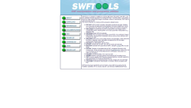
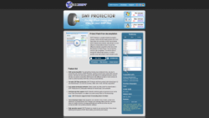
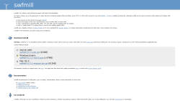
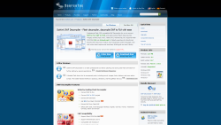
Existing Tools
SWFTools
Flash Dump Decompiler
swfmill
Sothink SWF Decompiler

Slide 10
Problems with existing tools
SWFTools
Flash Dump Decompiler
Crashes
Old
swfmill
Sothink SWF Decompiler
Wrong tool
Limited

Slide 11
Introducing SWFRETools
Tools for working with SWF Files
Open source (GPL 2.0)
Specifically made for RE

Slide 12
Goals
Ship
Enable
Standardize

Slide 13
Architecture
SWFRETools
Parser
Flash Dissector
Minimizer
Scripts
Debugger

Slide 14
Tool I: The Parser
Backbone
Reusable
Made for RE

Slide 15
Parser Goals
Complete
Improve
Share

Slide 16
Workflow Intermezzo I
Look at crash
Root cause analysis
Minimal repro file
Detection logic

Slide 17
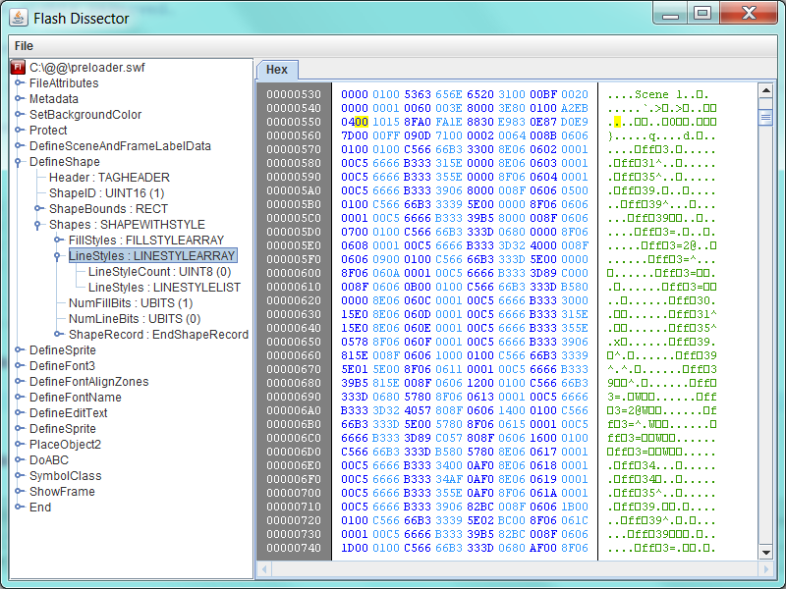
Tool 2: Flash Dissector

Slide 18
Flash Dissector Goals
Visualize
Popularize
Standardize

Slide 19
Flash Dissector Demo

Slide 20
Weaknesses of Flash Dissector
Incomplete
ActionScript handling
Editability

Slide 21
Flash Dissector Future
Plugins
Code Analysis
Debugging GUI

Slide 22
Workflow Intermezzo II
Look at crash
Root cause analysis
Minimal repro file
Detection logic

Slide 23
Static analysis vs Dynamic analysis
Flash Player trips up
Static tools become useless
Dynamic analysis required

Slide 24
Detour: Flash Player Debugger
Download: FP Project Content Debugger
Google: mmcfg treasure
Use: Process Monitor to find file location
Enjoy: Verbose ActionScript 3 log

Slide 25
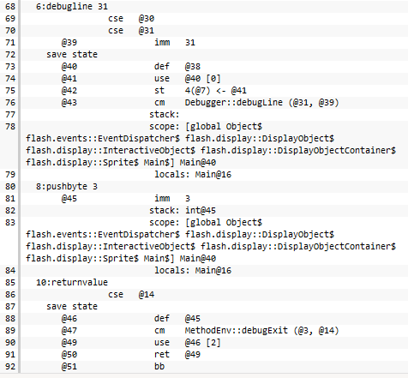
Detour: Flash Player Debugger

Slide 26
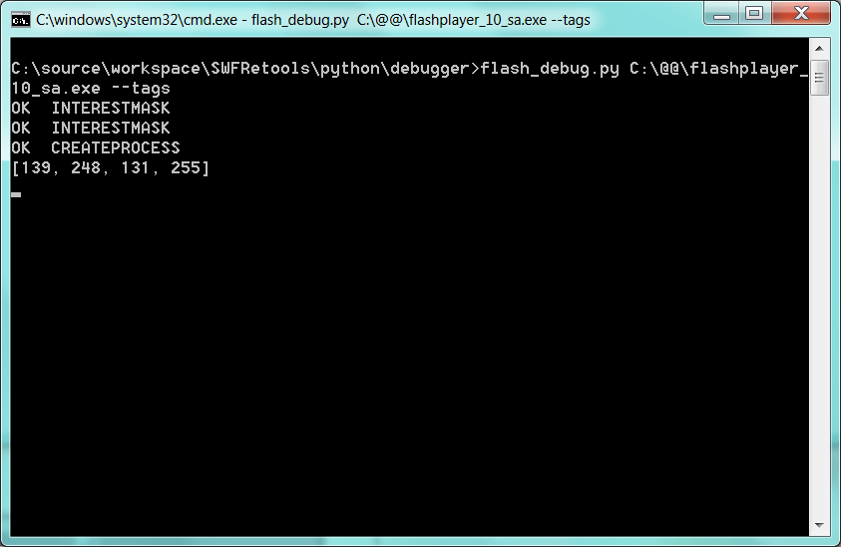
Tool III: Tracer/Debugger

Slide 27
Tracer Implementation
Console Application
Uses Buggery by grugq
Strategic placement of breakpoints

Slide 28
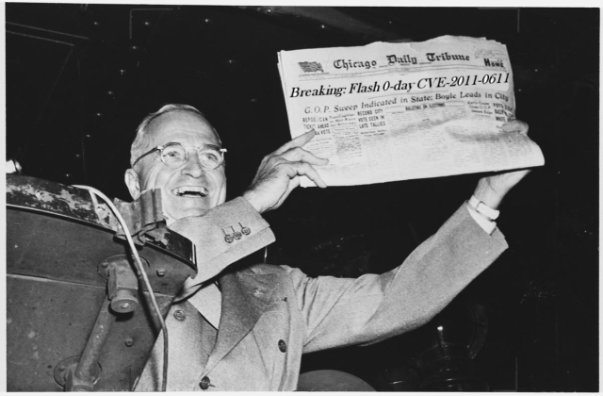
Last week in China

Slide 29
Last week in China
Remember x86 lessons
ActionScript Instrumentation
Auto-generate clean code

Slide 30
Tracer Plans
Extend
Improve
Keep updated

Slide 31
Workflow Intermezzo III
Look at crash
Root cause analysis
Minimal repro file
Detection logic

Slide 32
Minimizing sample files
With template
Compare crash file to template
Binary search until crash disappears
Without template
Remove tags
NOP ActionScript code

Slide 33
Minimizing files without templates
Remove tags
Simple due to linked list structure
NOP ActionScript code
Do not forget RETURN instructions

Slide 34
Do not forget RETURN
Function A
Function B
Crash here

Slide 35
Tool IV: Minimizer
Automated minimization
Console program
Remove section, check for crash

Slide 36
Automated minimizing
Remove tags
Make sure crash still occurs
NOP ActionScript code
Make sure crash still occurs
Repeat process until done

Slide 37
Minimizer Goals
Minimize
???
Profit

Slide 38
Off to GitHub we go!
Shipped!
https://github.com/sporst

Slide 39

Call for participation

Slide 40
Summary
There is a new tool in town
You can participate!
You can build upon it!
You can submit ideas!

Slide 41


Questions?

Slide 42
Questions?
Where do I get the slides?

Slide 43
Questions?
Why are you using Java?

Slide 44
Questions?
What about Foxit Reader?

Slide 45
Questions?
What about offensive tools?

Slide 46

Thank you

Slide 47
Image Credits
http://www.flickr.com/photos/markchadwick/4592186576/

